Slide 1

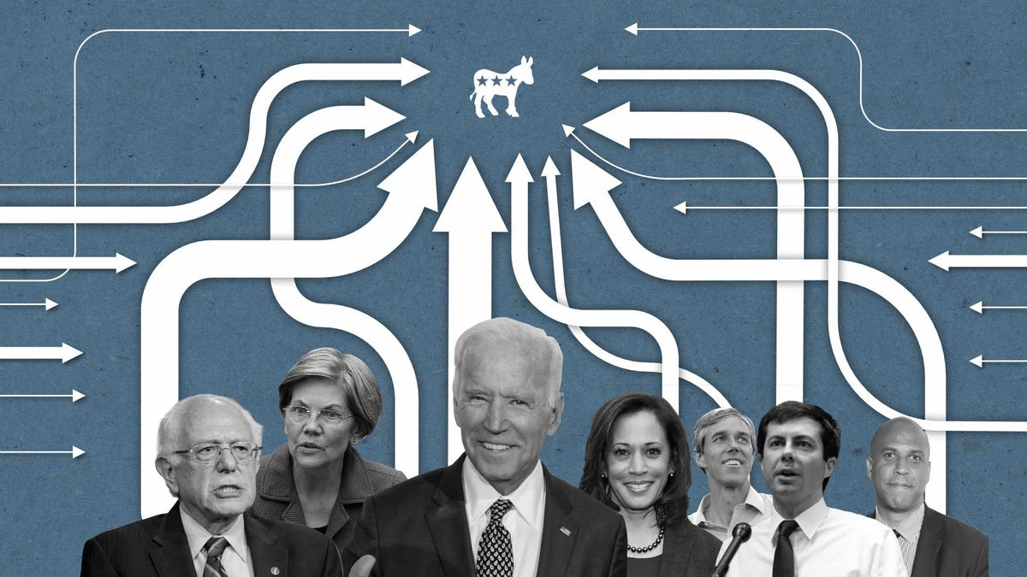

Democratic Presidential Nomination 2020 Data from Feb/2019 – Mar/2020
Presenters: Brad Reeves, Cheng Su, Paul Collet, Justin Phan

Slide 2
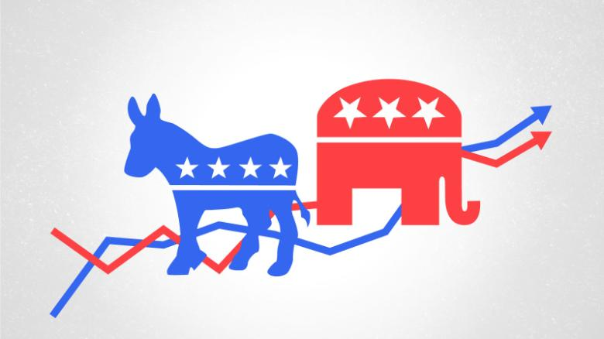
Democratic Primaries: Polls

Slide 3
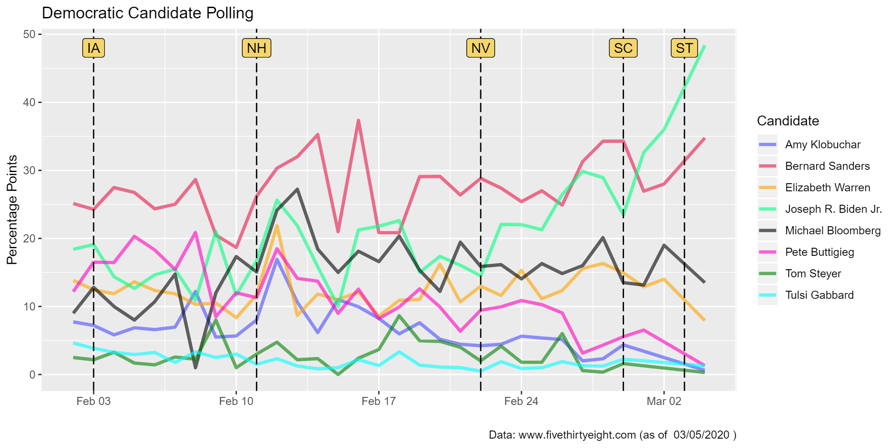
IA | - Iowa
NH | - New Hampshire
NV | - Nevada
SC | - South Carolina
ST | - Super Tuesday (Multiple)

Slide 4
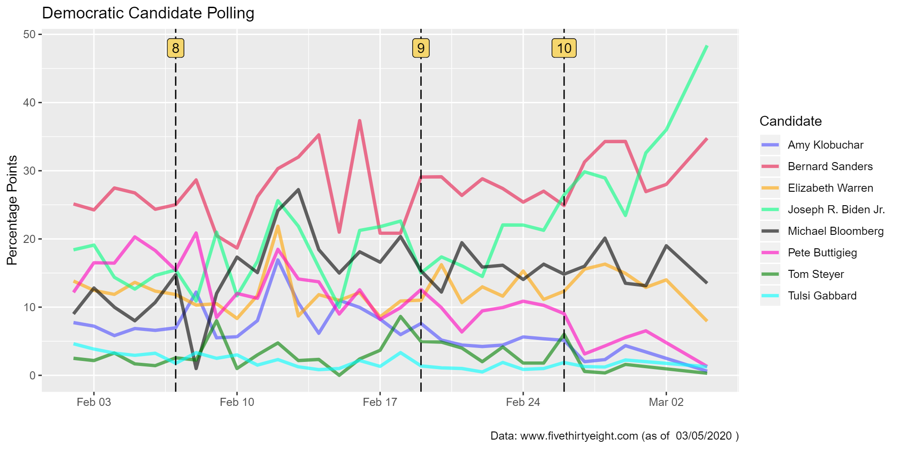
Based on 8th, 9th, and 10th
Democratic Debates

Slide 5
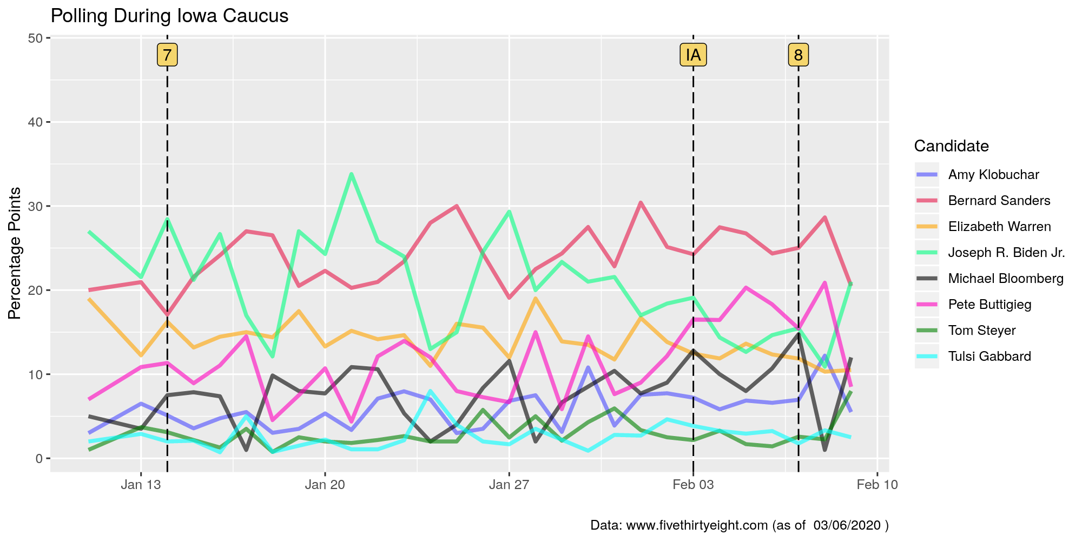

Slide 6
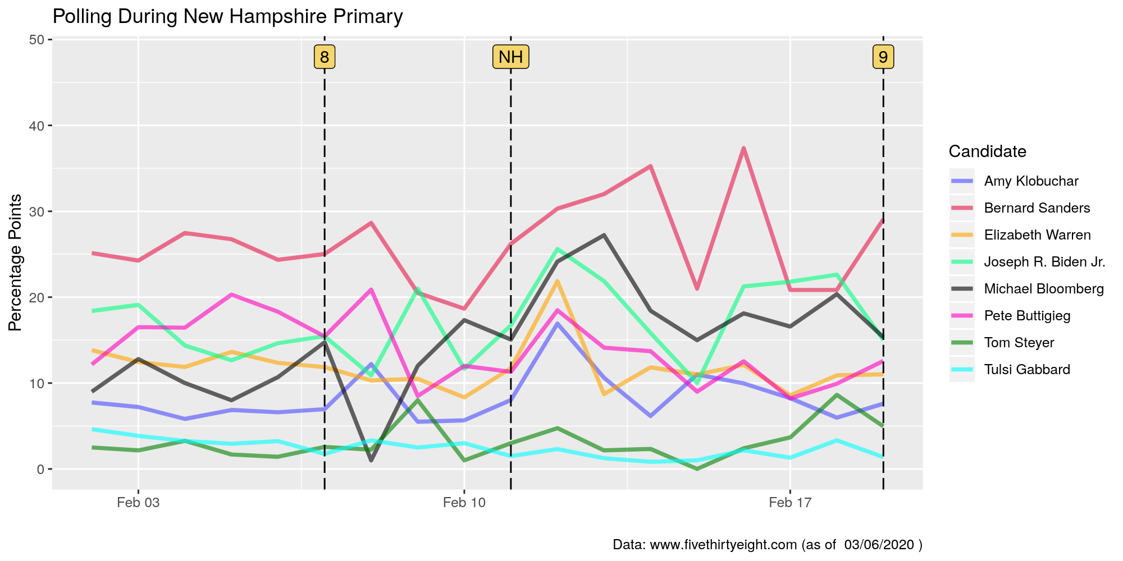

Slide 7
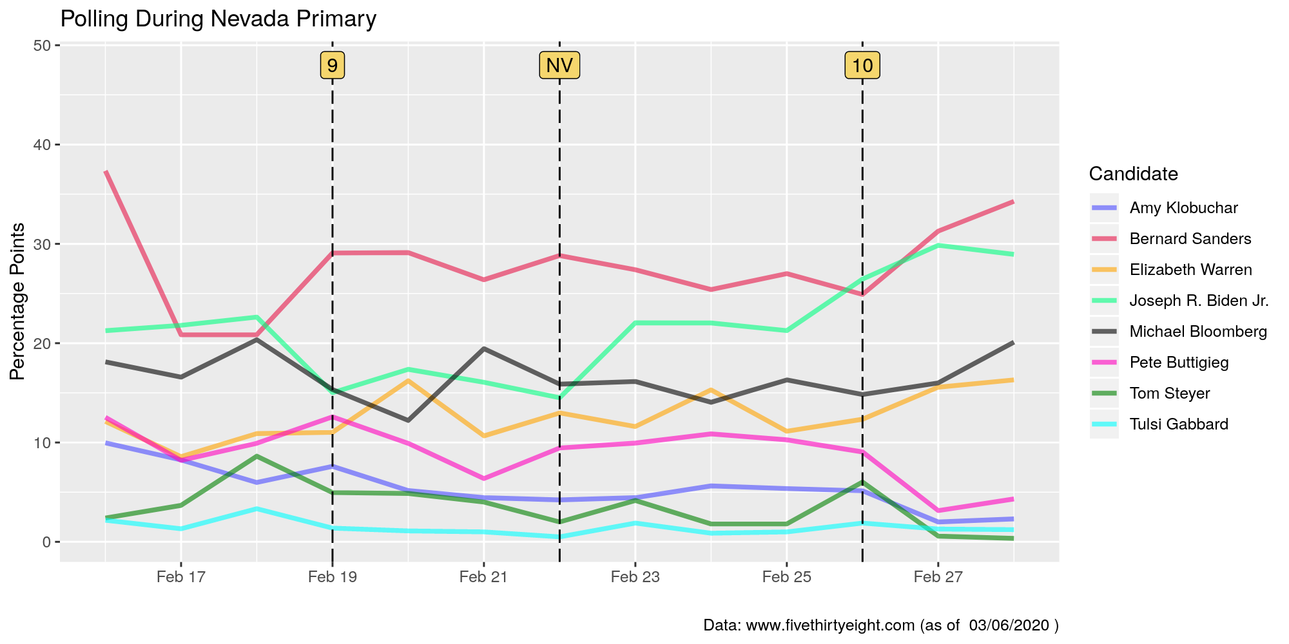

Slide 8
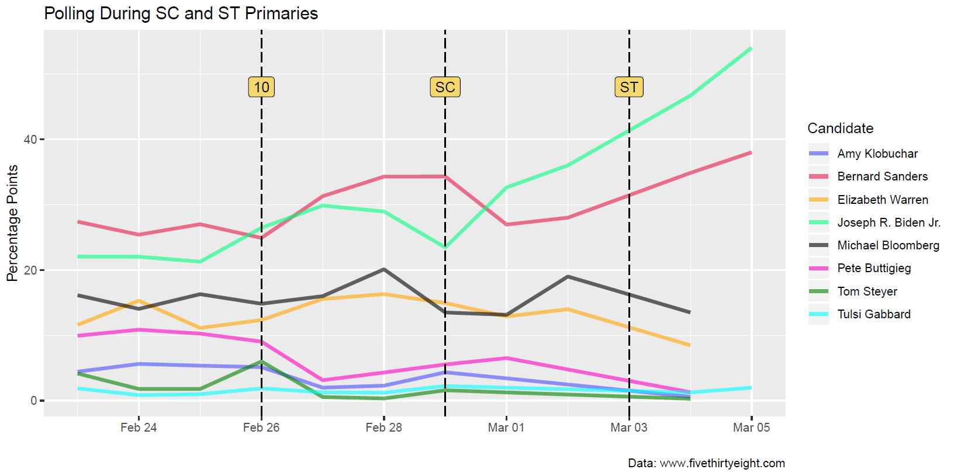
Notes:
I’ll replace this as soon as we have data

Slide 9

Democratic Primaries: Funding

Slide 10
Democratic Presidential Funding
Source of funding include:
IND: Individuals
CAN: Candidate
CMM: Campaign committee
COM: Other committee
ORG: Organization
PTY: Political party committee
PAC: Political action committee

Slide 11
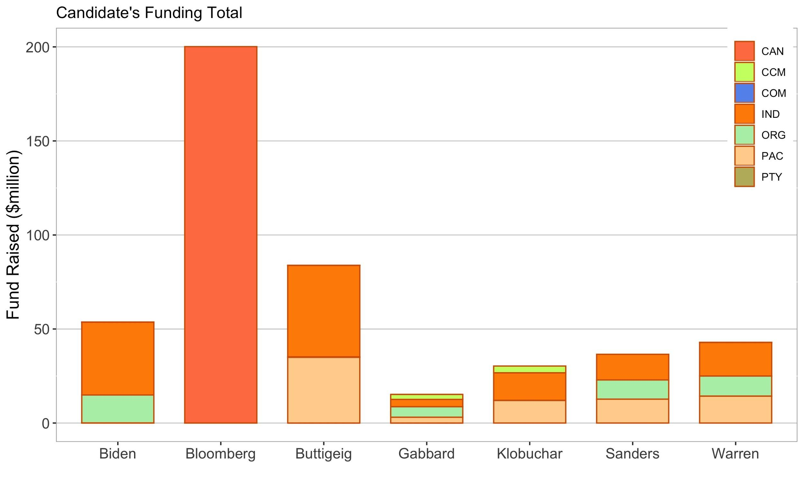
Funding - National
Accumulated since 2019 Q1

Slide 12
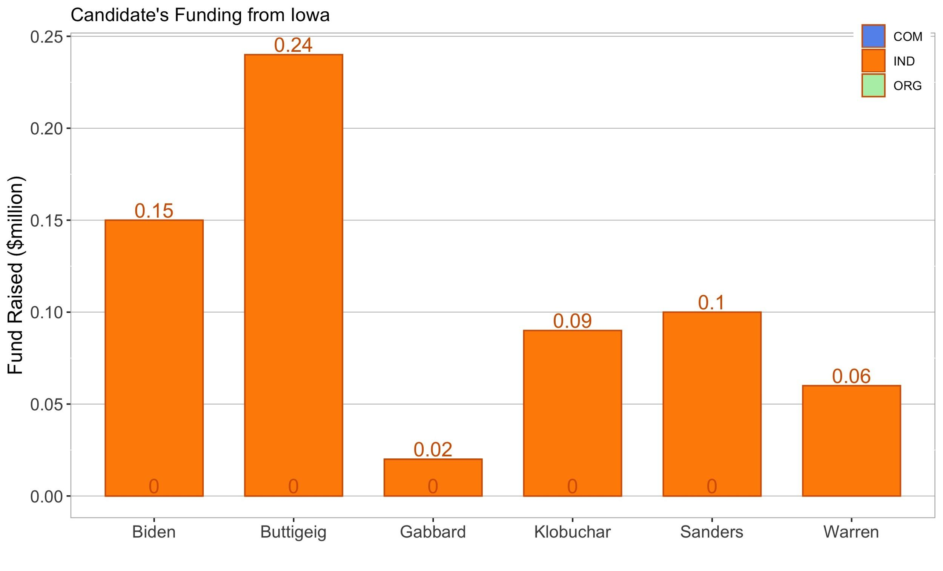
Funding - IOWA
Candidate | Delegates | % | Count
Buttigeig | 14 | 26.2% | 563
Sanders | 12 | 26.1% | 562
Warren | 8 | 18% | 388
Biden | 6 | 15.8% | 340
Accumulated since 2019 Q1

Slide 13
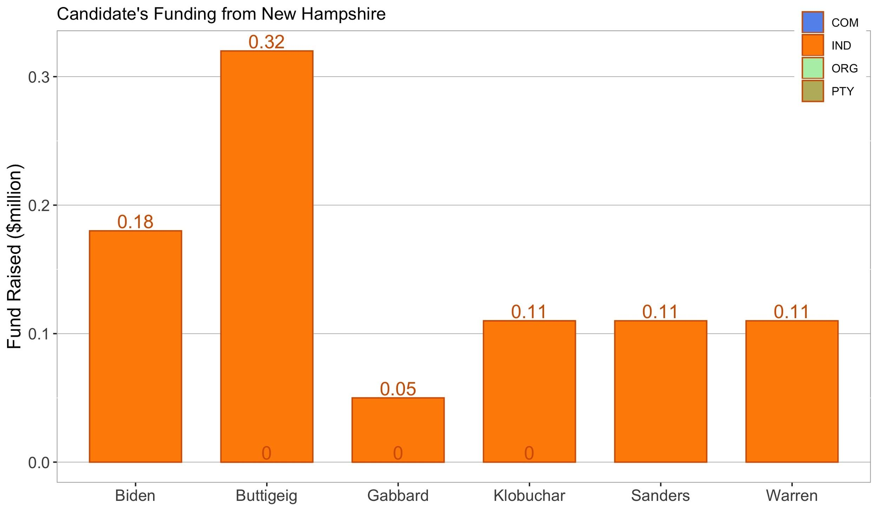
Funding - New Hampshire
Candidate | Delegates | % | Count
Sanders | 9 | 25.7% | 76324
Buttigieg | 9 | 24.2% | 72457
Klobuchar | 6 | 19.8% | 58796
Warren | 0 | 9.2% | 27387
Accumulated since 2019 Q1

Slide 14
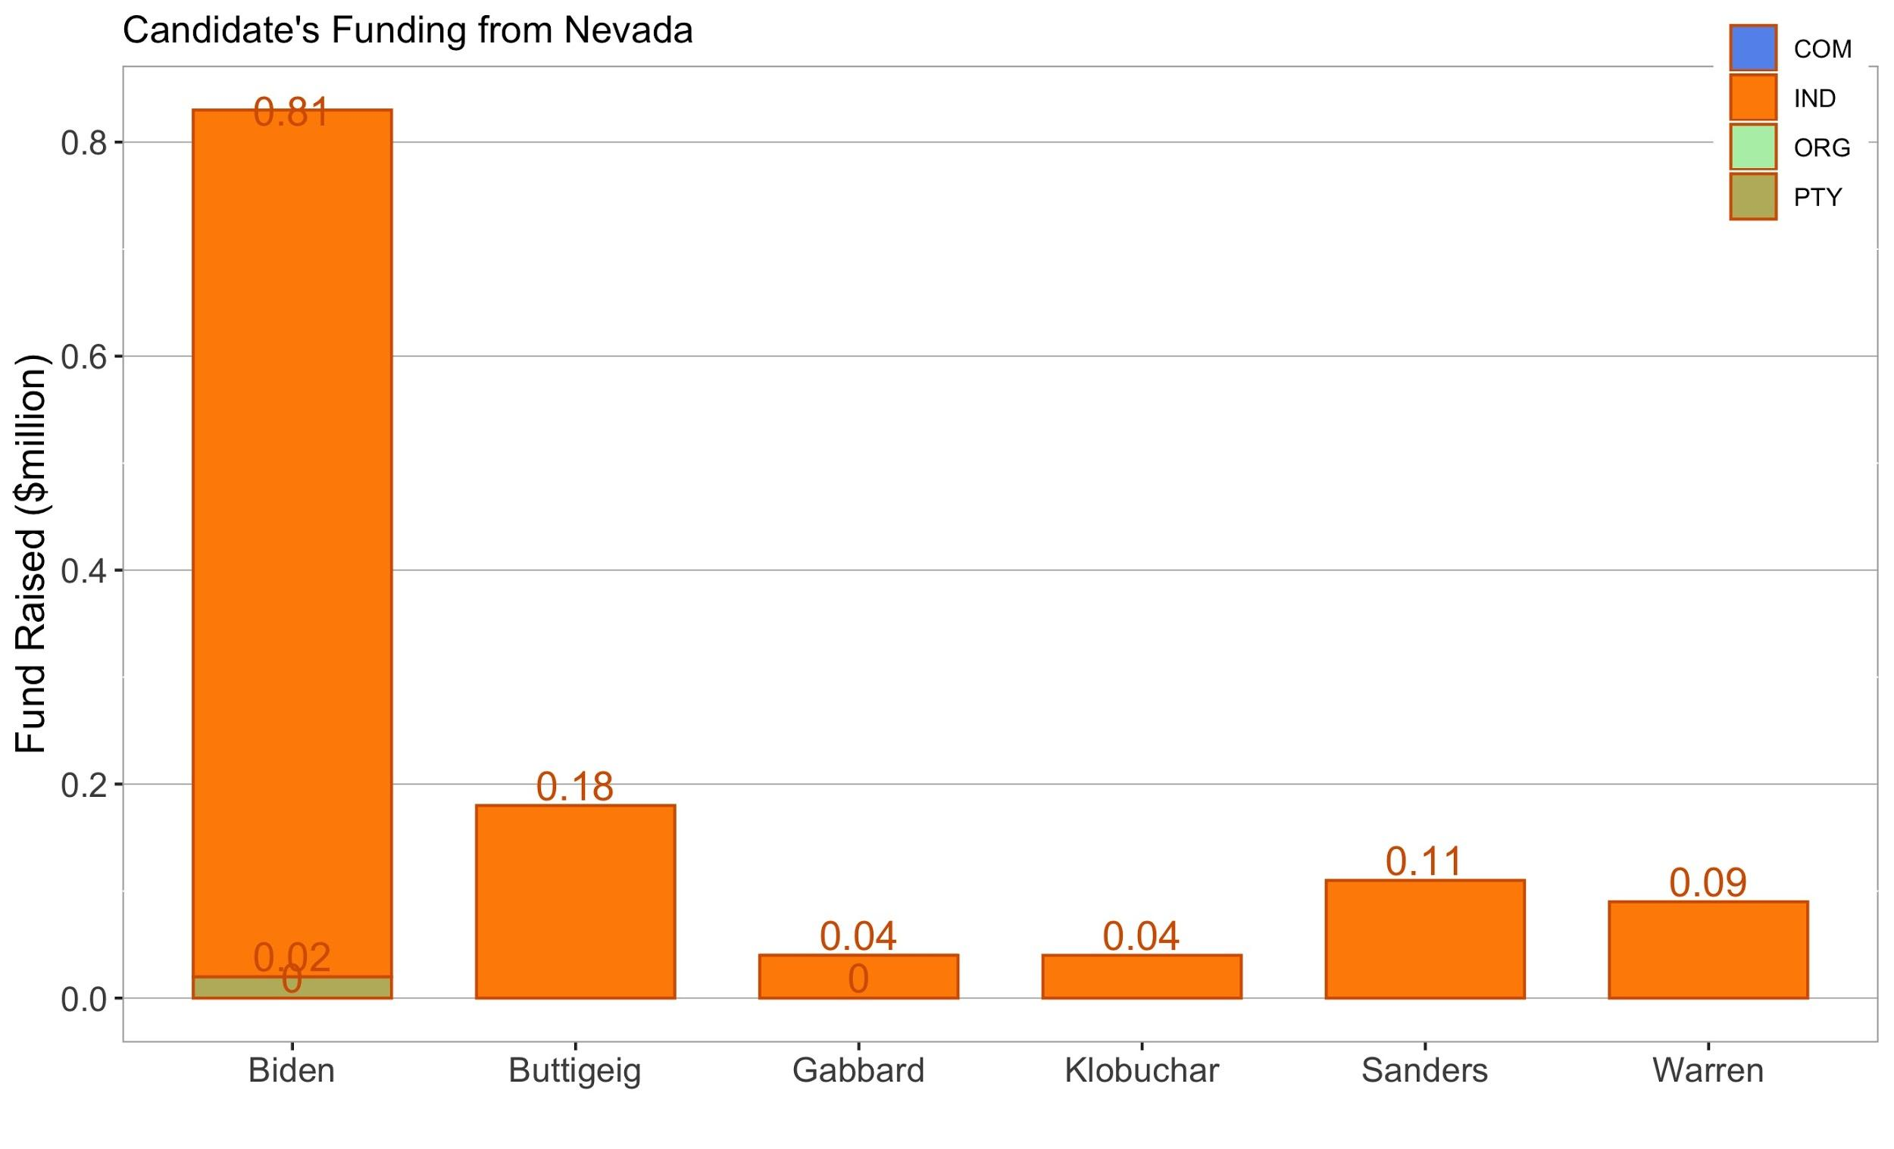
Funding - Nevada
Candidate | Delegates | % | Count
Sanders | 24 | 46.8% | 6788
Biden | 9 | 20.2% | 2927
Buttigieg | 3 | 14.3% | 2073
Warren | 0 | 9.2% | 1406
Accumulated since 2019 Q1

Slide 15
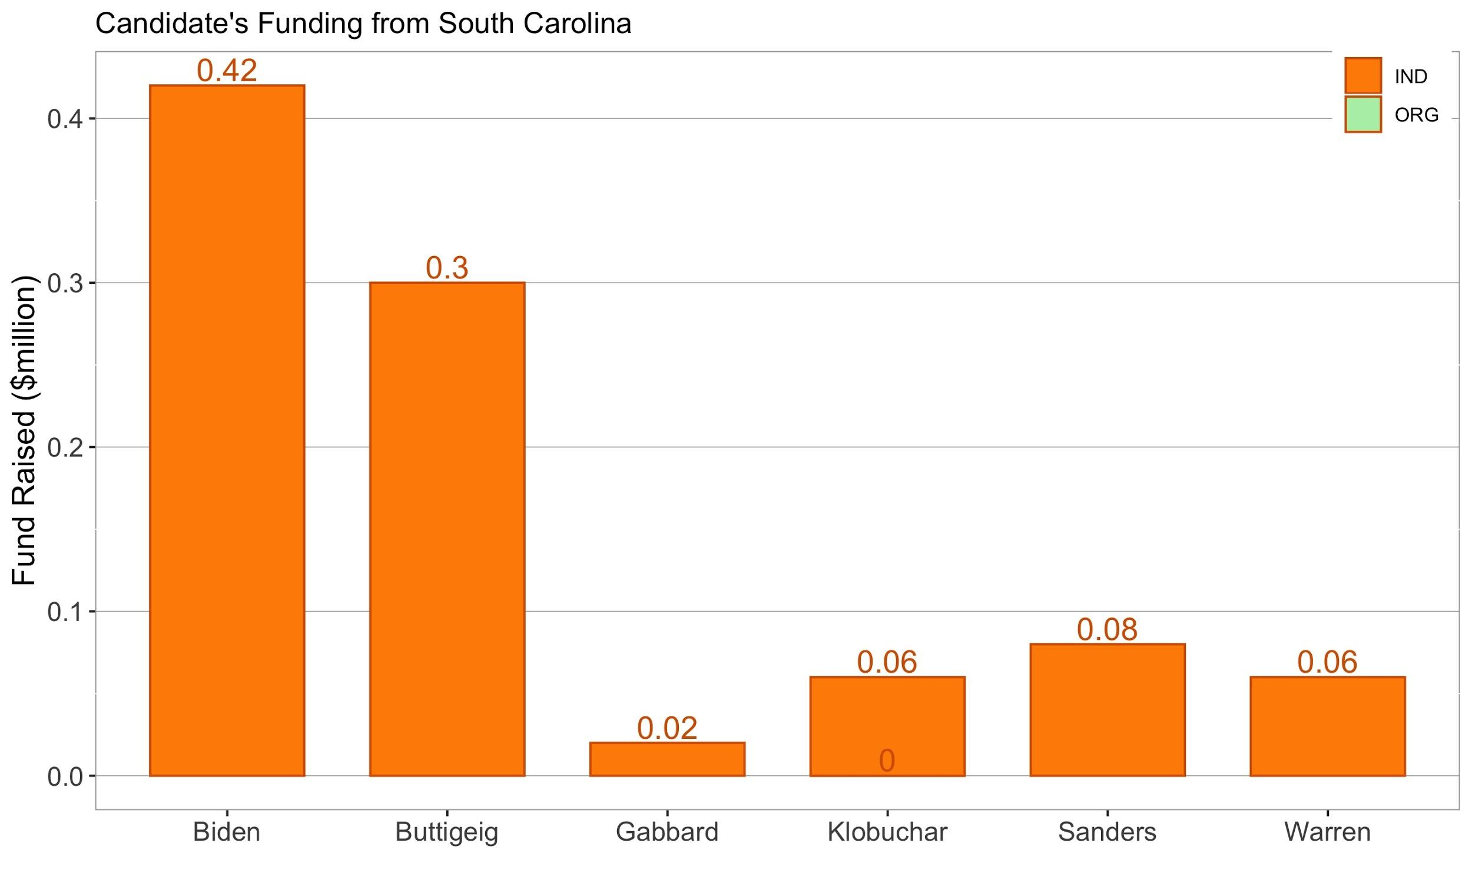
Funding - South Carolina
Candidate | Delegates | % | Count
Sanders | 39 | 48.4% | 256,047
Biden | 15 | 19.9% | 105,197
Steyer | 0 | 11.3% | 59,893
Buttigieg | 0 | 8.2% | 43,606
Accumulated since 2019 Q1

Slide 16
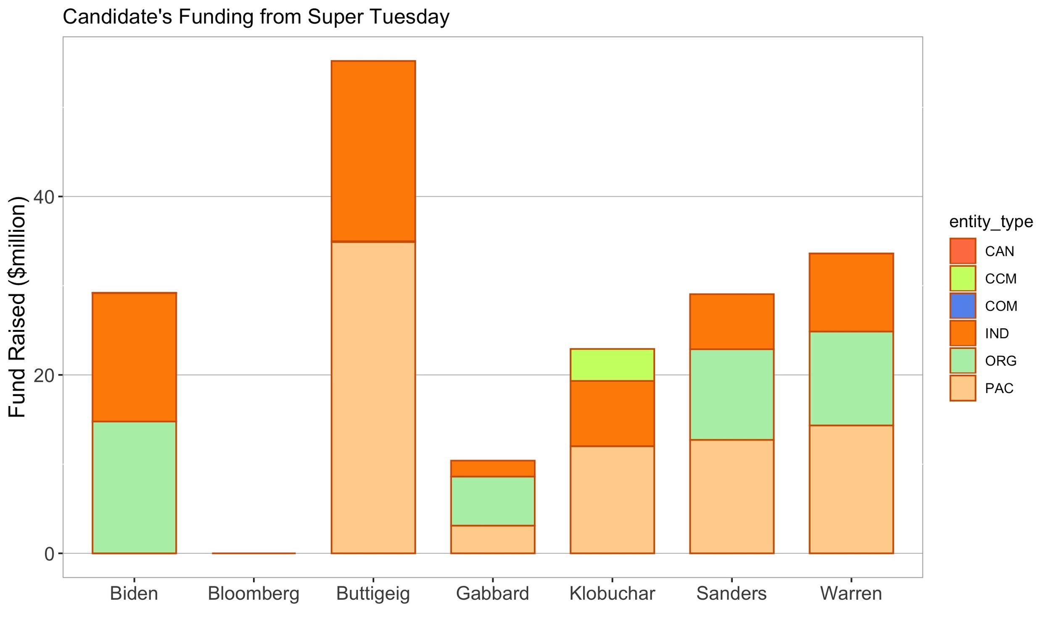
Funding - Super Tuesday
Candidate | Delegates | % | Count
- | - | - | -
- | - | - | -
- | - | - | -
- | - | - | -
Accumulated since 2019 Q1

Slide 17
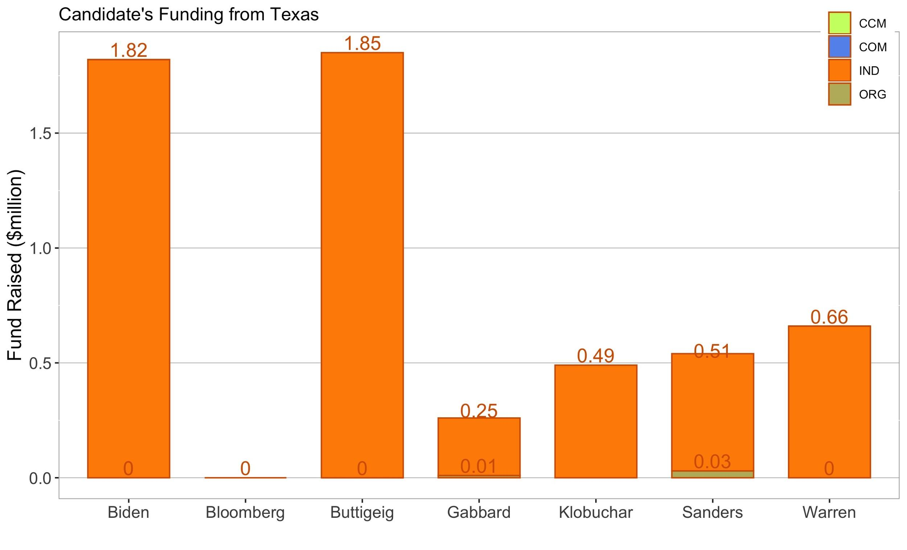
Funding - Super Tuesday(Texas)
Candidate | Delegates | % | Count
Biden | 81 | 34.5% | 716,030
Sanders | 72 | 30% | 622,360
Bloomberg | 5 | 14.4% | 298,262
Warren | 1 | 11.4% | 237,028
Accumulated since 2019 Q1

Slide 18
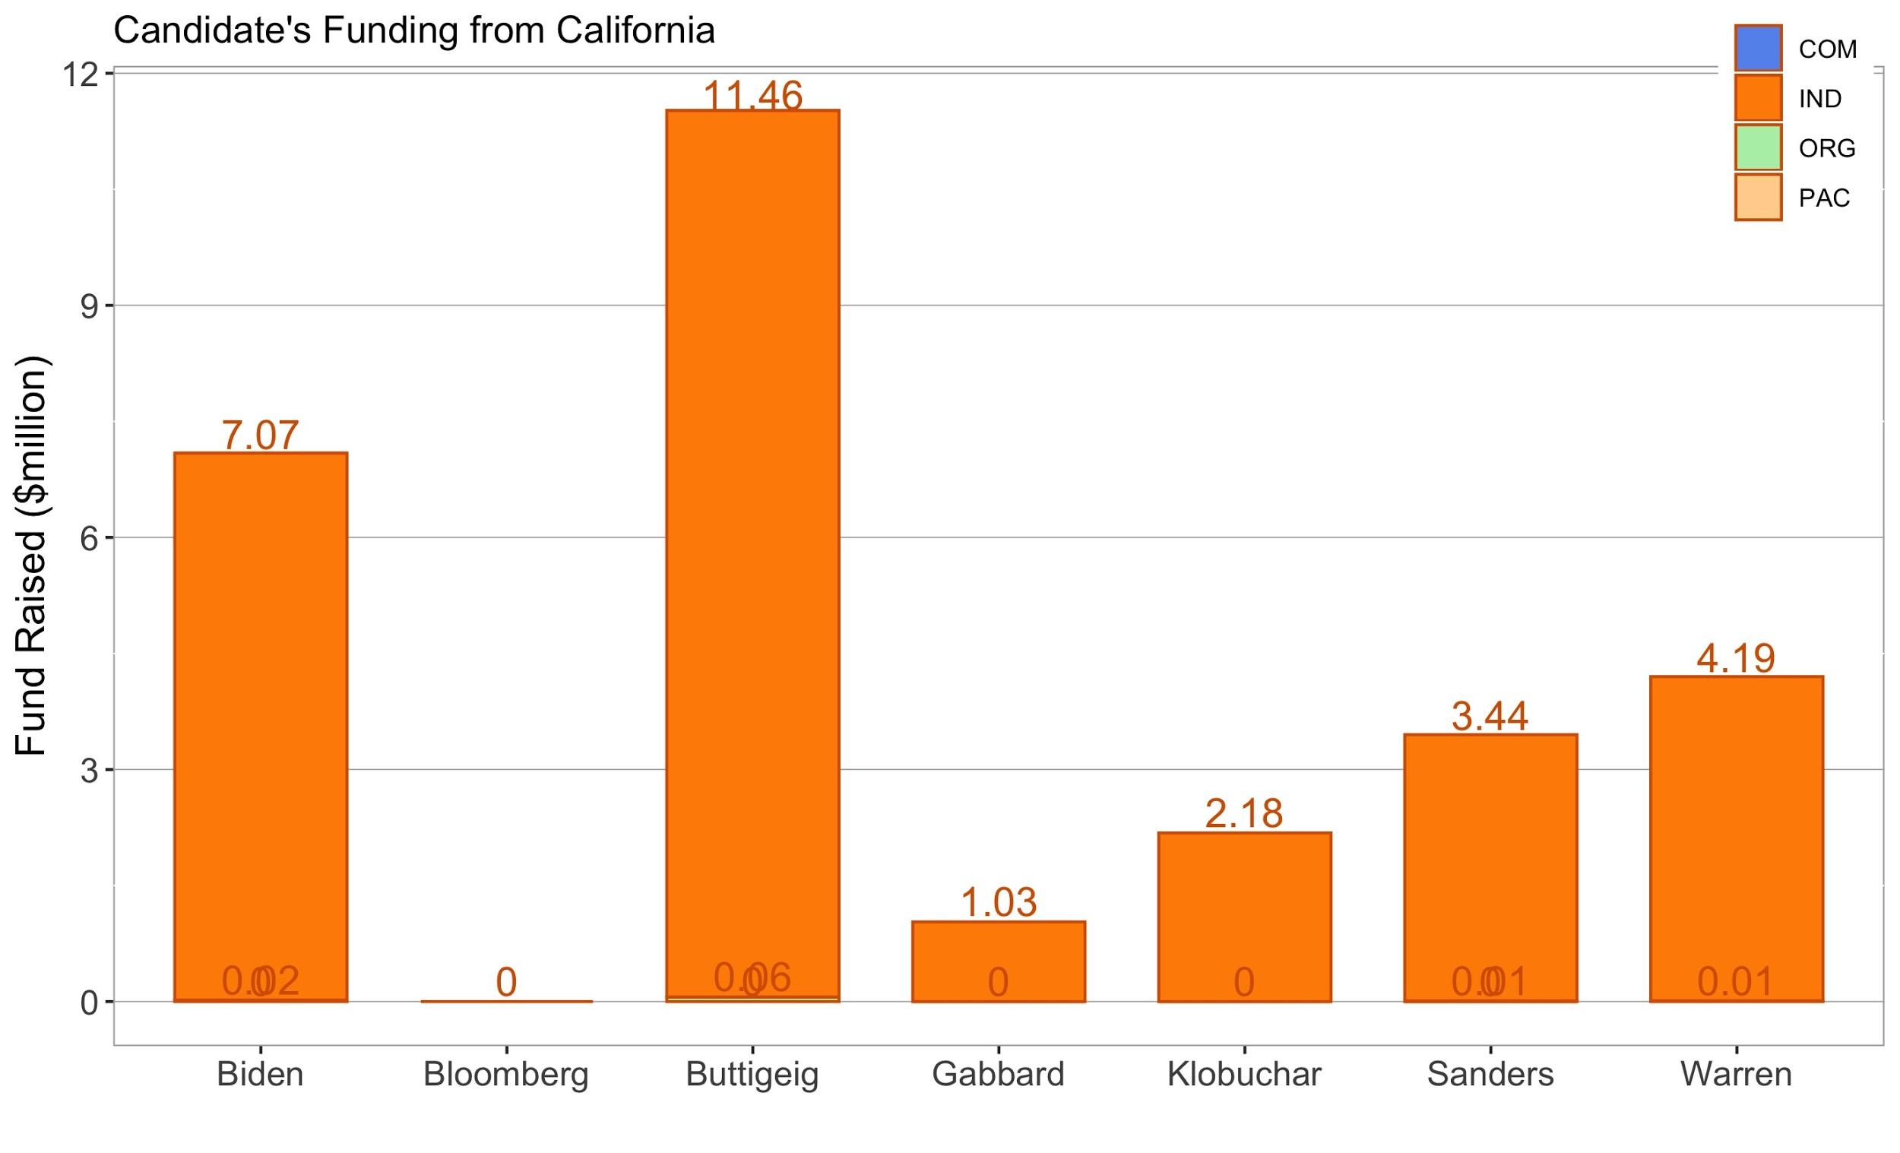
Funding - Super Tuesday(California)
Candidate | Delegates | % | Count
Sanders | 155 | 33.8% | 1,049,065
Biden | 93 | 25.1% | 778,697
Bloomberg | 14 | 14.1% | 437,388
Warren | 9 | 12.1% | 375,820
Accumulated since 2019 Q1

Slide 19
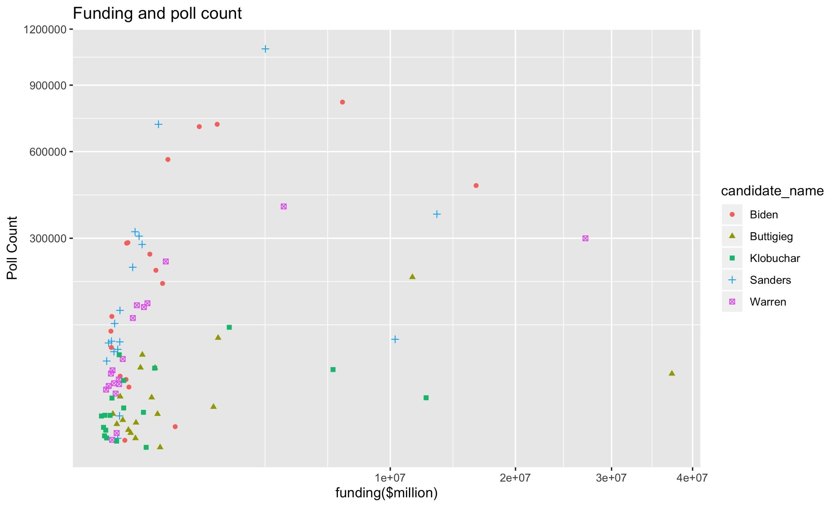
Funding - fit
Accumulated since 2019 Q1

Slide 20
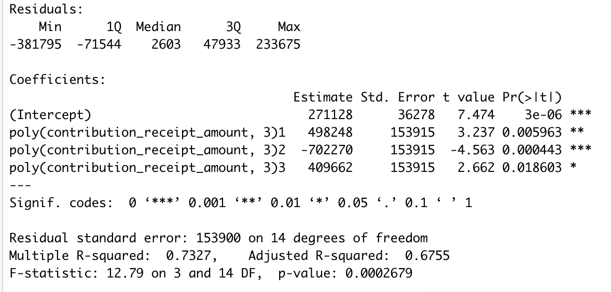
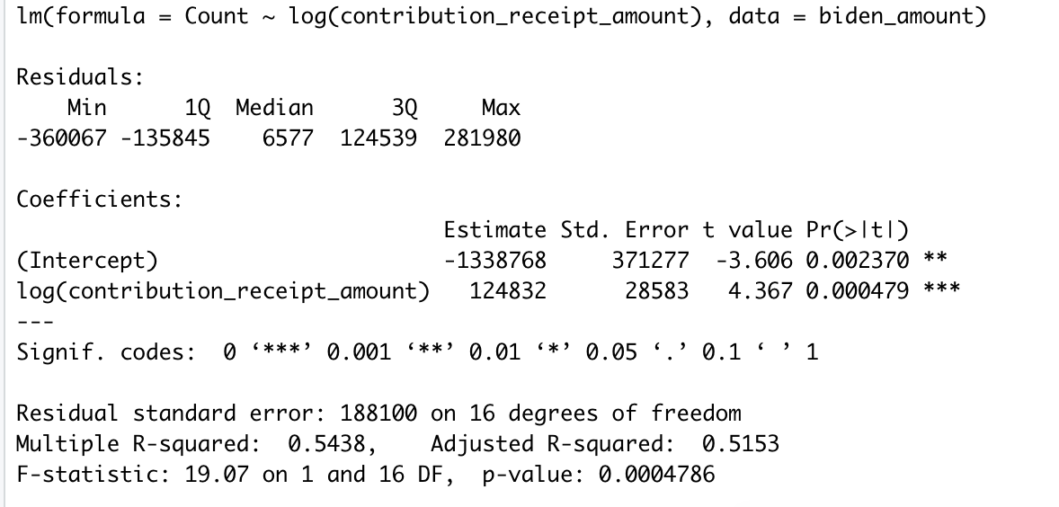
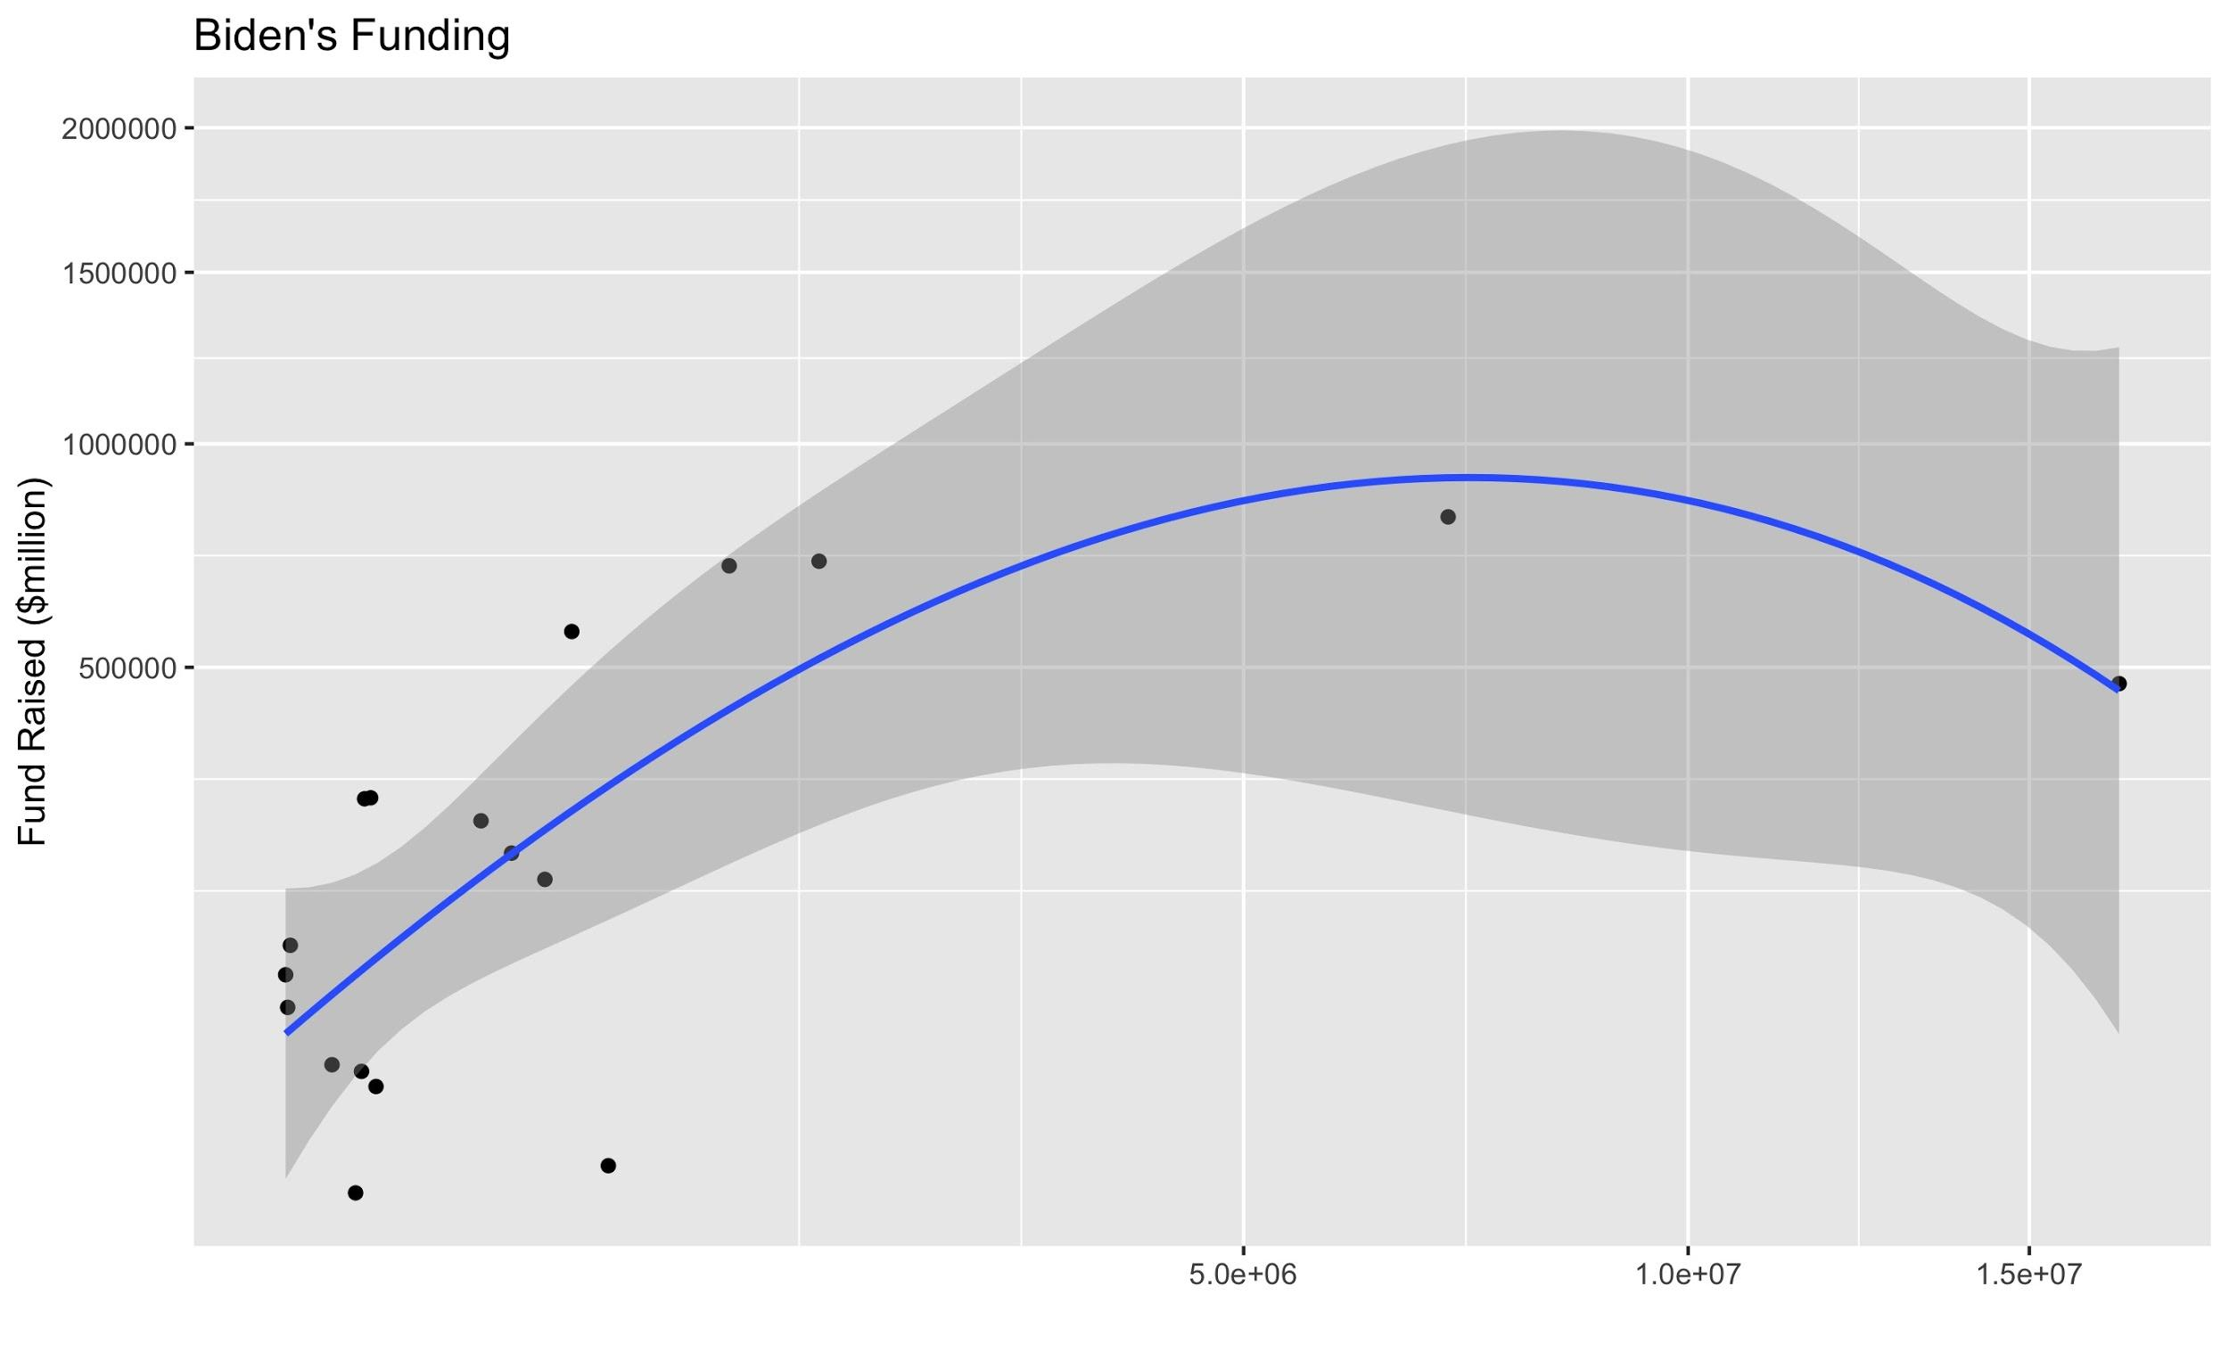
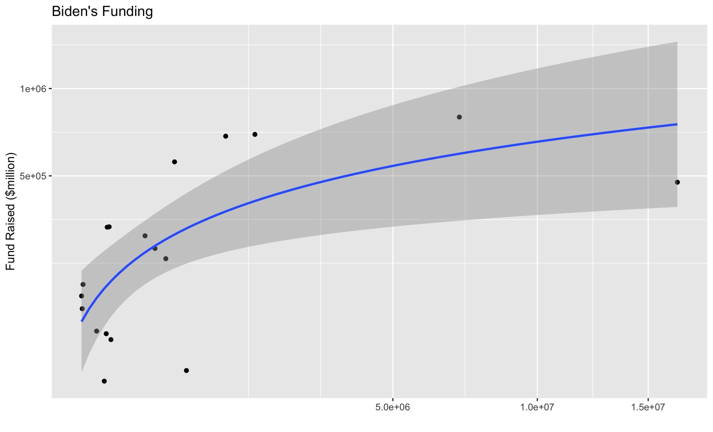
Funding - fit
Accumulated since 2019 Q1

Slide 21
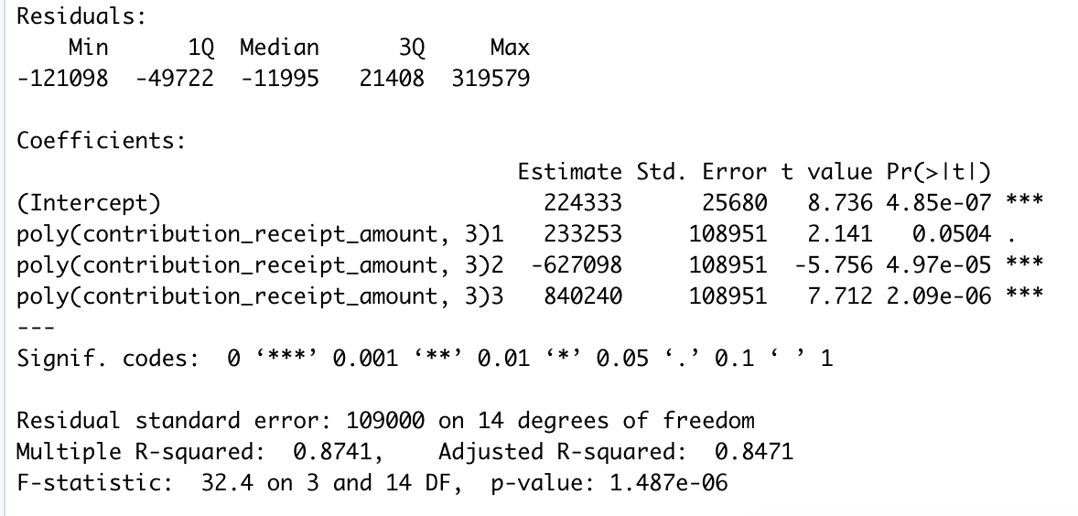
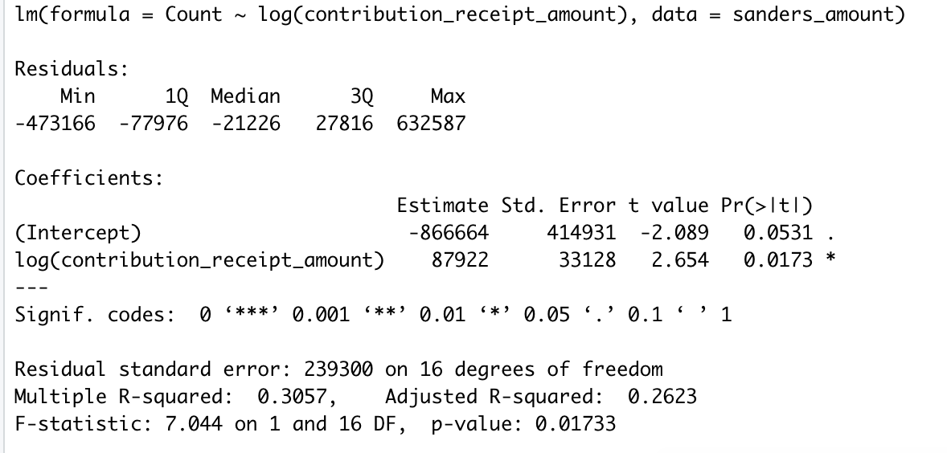

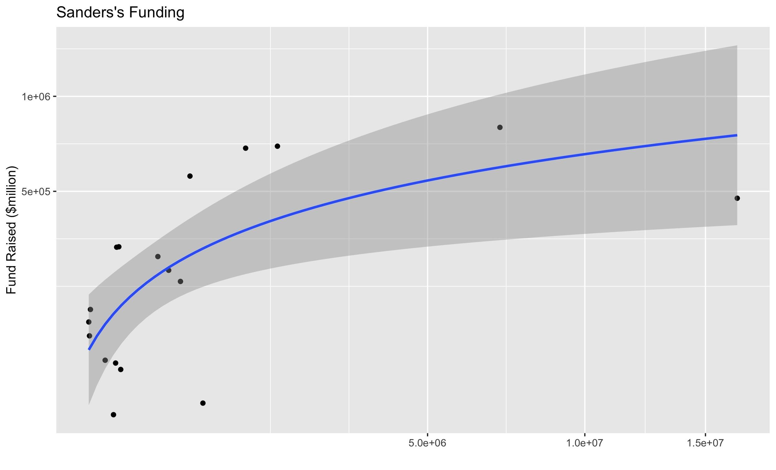
Funding - fit
Accumulated since 2019 Q1

Slide 22

Democratic Primaries: Ad Spending

Slide 23
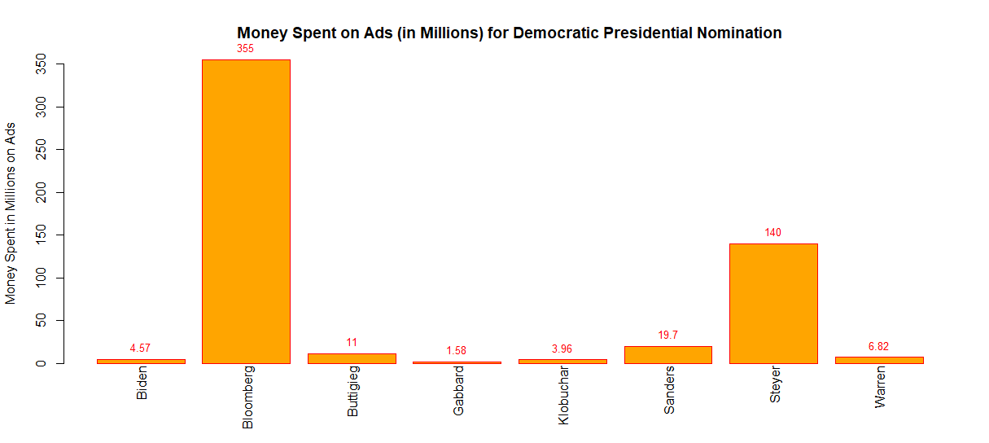
National Ads Spending (07/2019 - 02/2020)

Slide 24
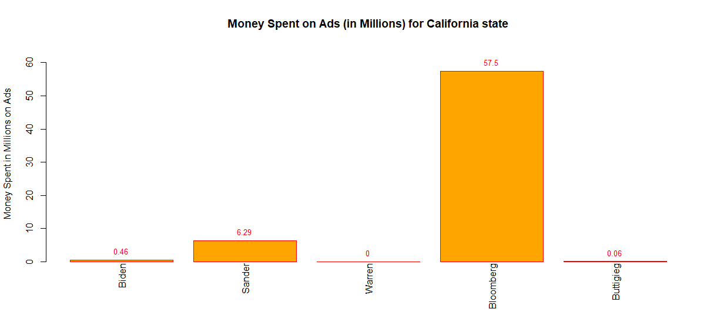
California Ads (07/2019 - 02/2020)
Top 5 Candidates
Biden | 35%
Sander | 28%
Bloomberg | 18%
Warren | 14%
Pete | 7%

Slide 25
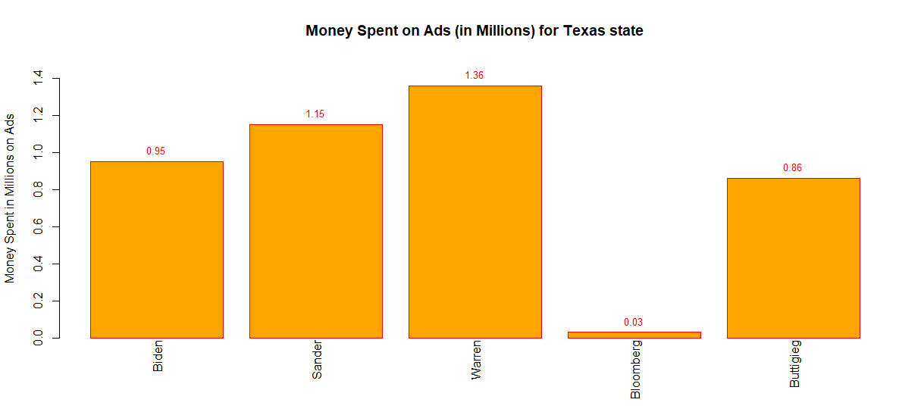
Texas Ads (07/2019 - 02/2020)
Top 5 Candidates
Biden | 35%
Sander | 28%
Bloomberg | 18%
Warren | 14%
Pete | 7%

Slide 26
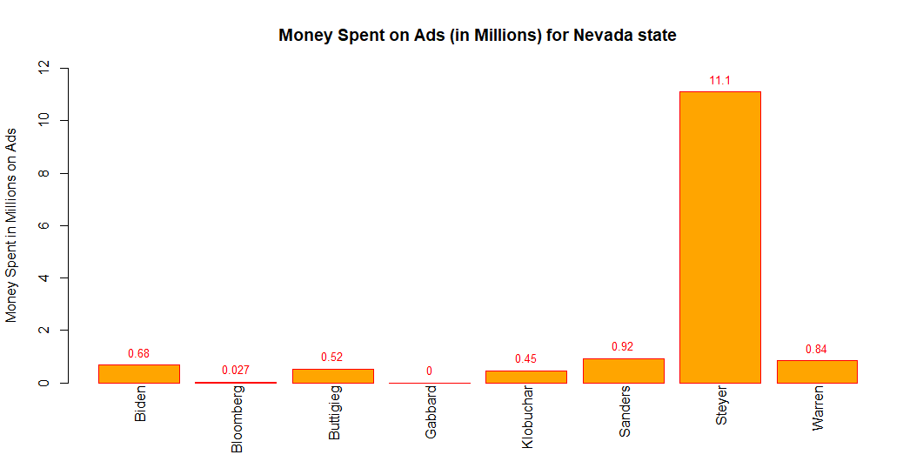
Nevada Ads (07/2019 - 02/2020)
Top 5 Candidates
Sander | 32%
Pete | 25%
Biden | 20%
Warren | 15%
Bloomberg | 13%

Slide 27
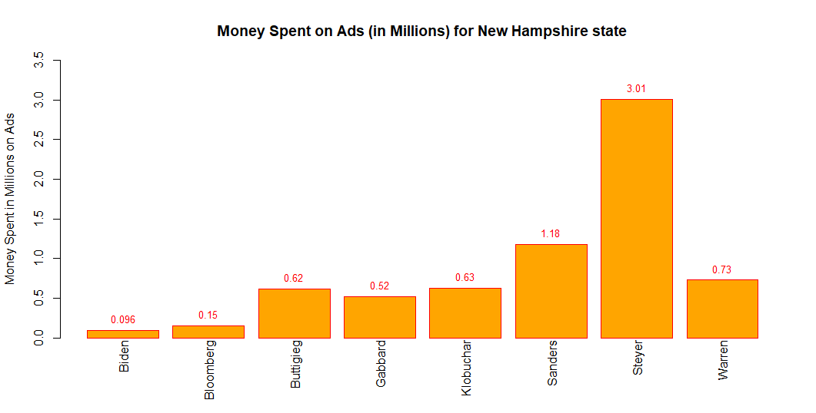
New Hampshire Ads (07/2019 - 02/2020)
Top 5 Candidates
Sander | 26%
Biden | 19%
Bloomberg | 18%
Warren | 13%
Buttigieg | 12%

Slide 28
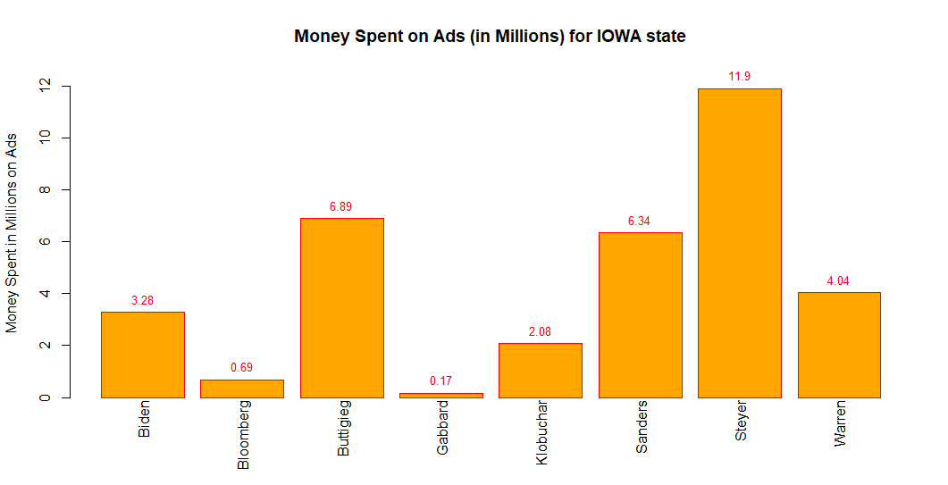
Iowa Ads (07/2019 - 02/2020)
Top 5 Candidates
Sander | 25%
Pete | 18%
Biden | 15%
Warren | 12%
Bloomberg | 12%

Slide 29
Delegates Awarded Data
del_df<-read.csv("../dat/delegates.csv", header=TRUE)
candidate<-colnames(del_df)[5:12]
delegates<-c(sum(del_df$Klobuchar), sum(del_df$Sanders), sum(del_df$Warren), sum(del_df$Biden),
sum(del_df$Bloomberg), sum(del_df$Buttigieg), sum(del_df$Steyer), sum(del_df$Gabbard))
delegates[is.na(delegates)]<-0
del_df<-data.frame(candidate, delegates)

Slide 30
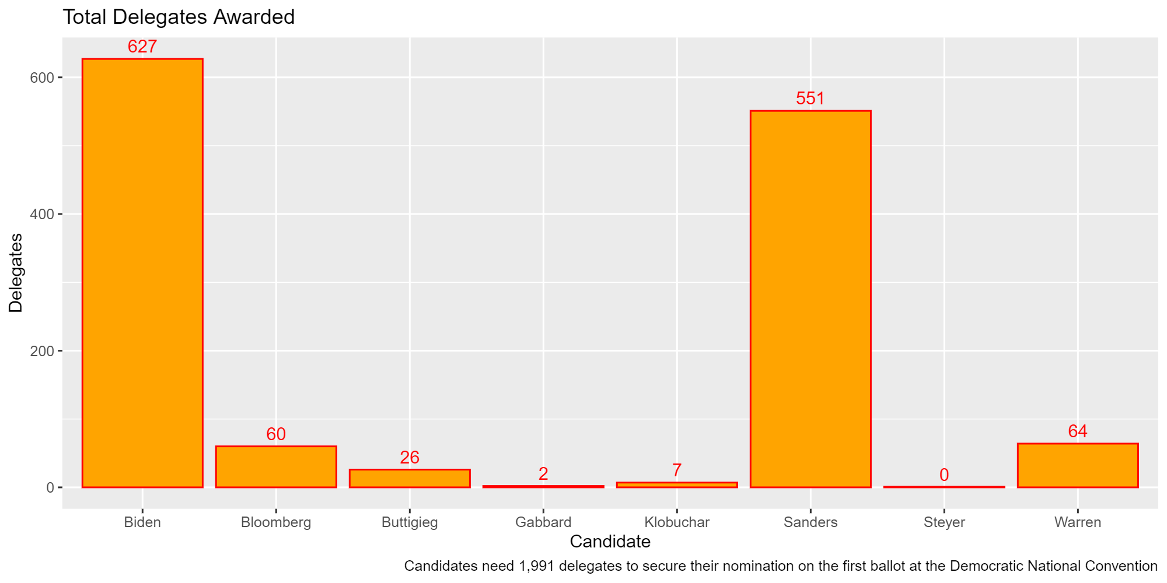

Slide 31
